Slide 1
WEEK 7 - DEMO
ANNIE NGUYEN
January 11, 2018

Slide 2





Bank of Simba

Slide 3
Raise account balance
POST /multipleAccounts
raise: 1
Controller
accountService.raiseBalance(ix);
View
(template)
@ModelAttribute("allBankAccounts")
(data binding)
Model

Slide 4
Raise account balance
Controller
@PostMapping(value = "/multipleAccounts", params = {"raise"}) public String submitAccount(final BankAccount bankAccount,
final HttpServletRequest req) { final Integer accountIndex = Integer.valueOf(req.getParameter("raise")); accountService.raiseBalance(accountIndex); return "bankofsimba2"; }
bankofsimba.html
<tr th:each = "account: ${allBankAccounts}"> <td th:text="${account.name}">...</td>
<--! fill in column value --> <td> <button type="submit" name="raise" th:value="${accountStat.index}">Raise</button> </td> </tr>

Slide 5
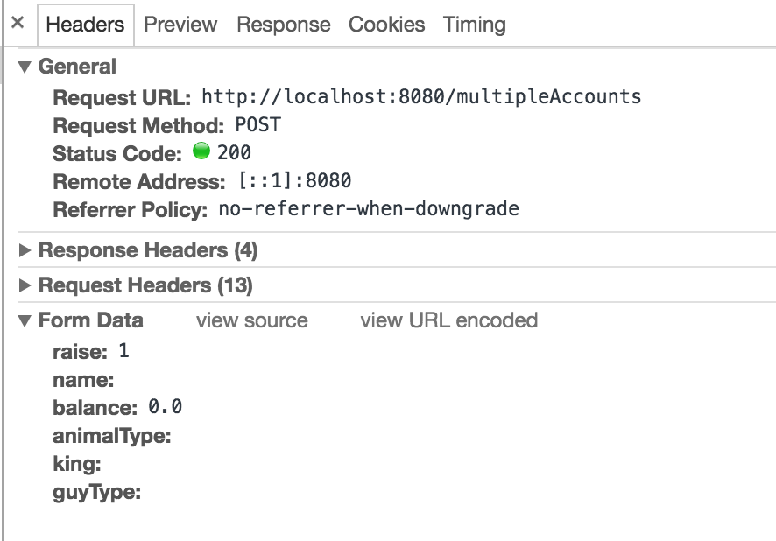

Slide 6
Add new account

Slide 7
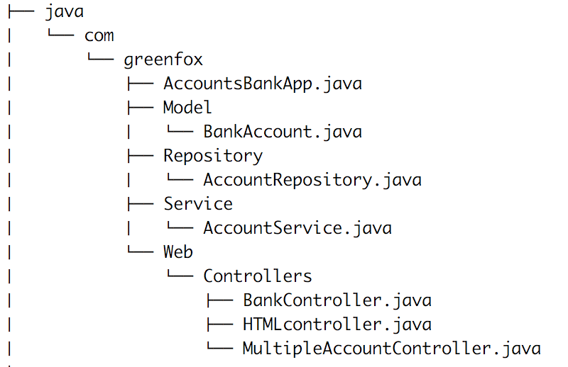
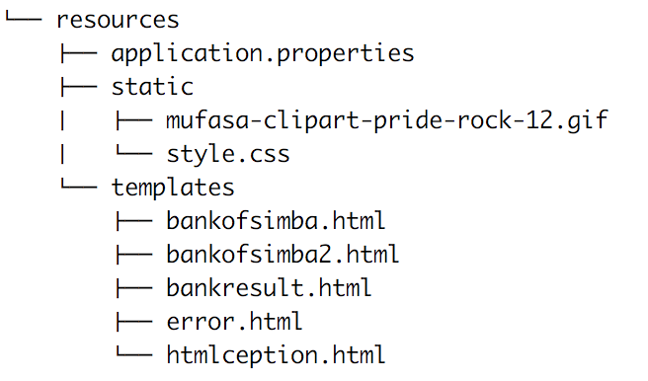
Directory Tree Markdown

Slide 8
@Repository public class AccountRepository { private final List<BankAccount> bankAccounts = new ArrayList<>(); public AccountRepository() { //populate data here bankAccounts.add(new BankAccount("Mufasa", 2500,
"lion", "King", "Good One")); } public List<BankAccount> findAll() { return this.bankAccounts; } public void add(final BankAccount bankAccount) { this.bankAccounts.add(bankAccount); } public void raiseBalance(int index) {} }

Slide 9
@Service public class AccountService { private final AccountRepository accountRepository; @Autowired public AccountService(AccountRepository accountRepository) { super(); this.accountRepository = accountRepository; } public List<BankAccount> findAll() { return this.accountRepository.findAll(); } public void add(final BankAccount bankAccount) { this.accountRepository.add(bankAccount); } public void raiseBalance(int index) { accountRepository.raiseBalance(index); } }

Slide 10
@Controller public class MultipleAccountController { private final AccountService accountService;
@Autowired MultipleAccountController(AccountService accountContainerService) { super(); this.accountService = accountContainerService; }
@ModelAttribute("allBankAccounts") public List<BankAccount> populateBankAccounts() { return this.accountService.findAll(); }
}

Slide 11
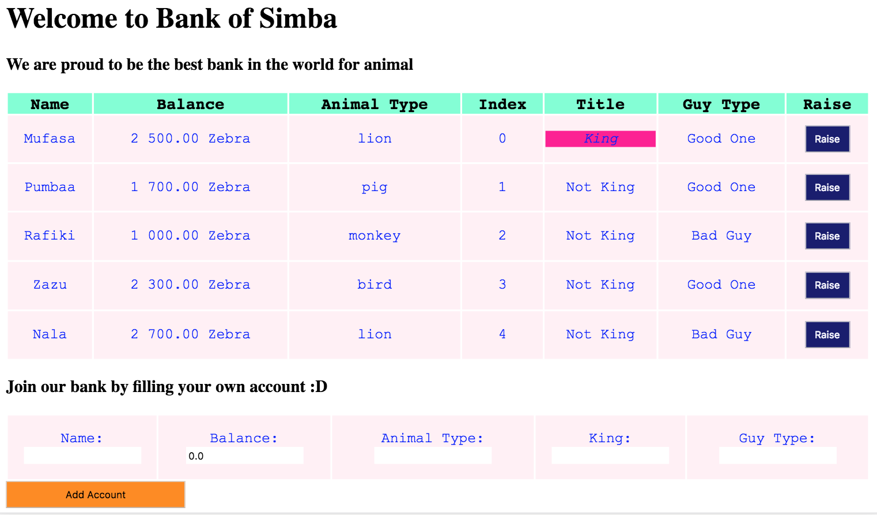

Slide 12
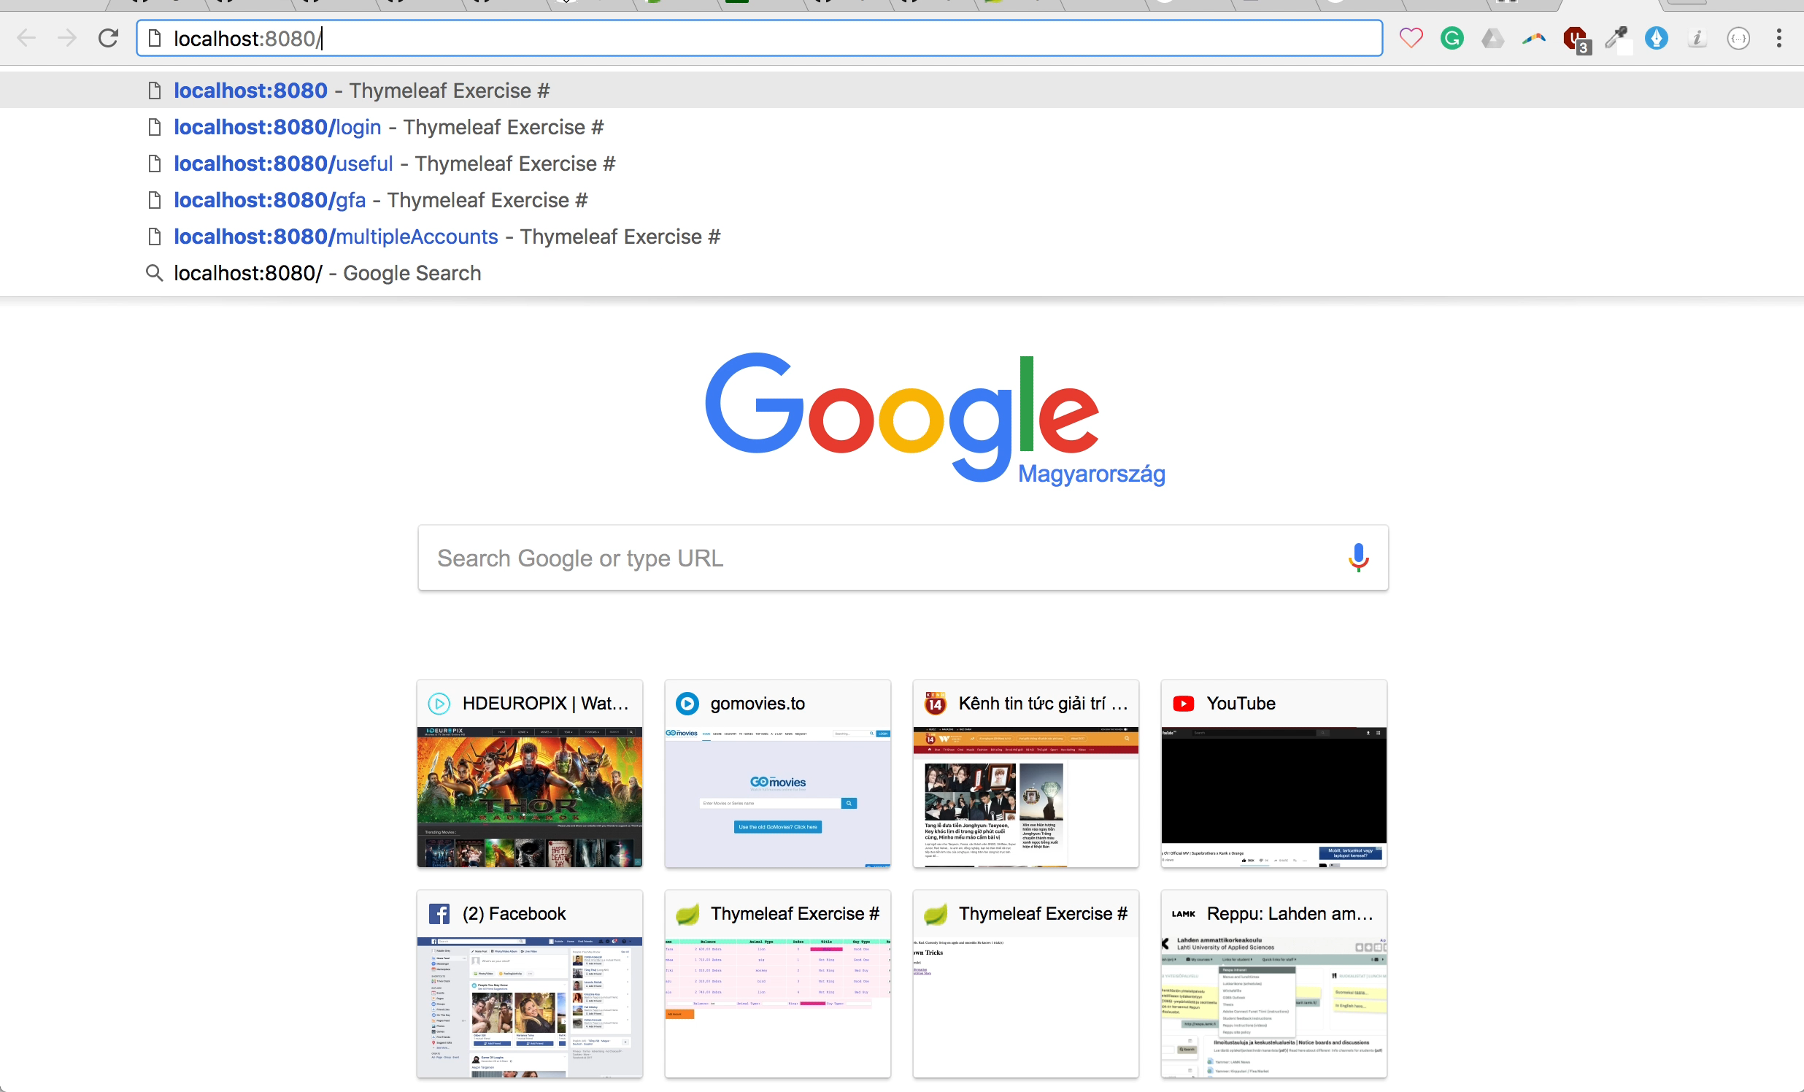

Slide 13
CAT BINDING
THANK YOU FOR YOUR ATTENTION

Slide 14
Bonus pic for u ☺

